Slide 1

Cajon Computer Society (CCS)
“Providing tomorrow’s ingenuity.”

Slide 2
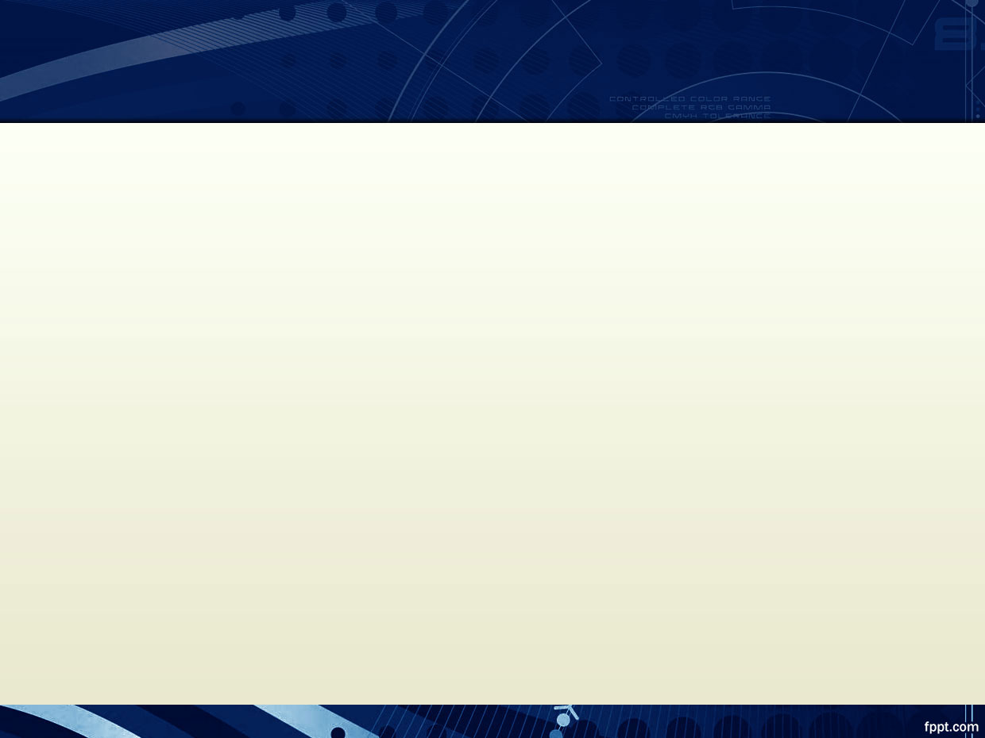
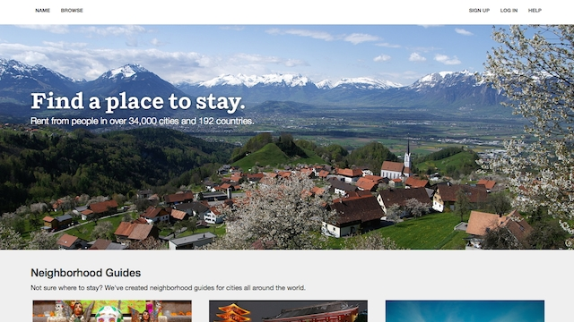
Websites: HTML/CSS

Slide 3
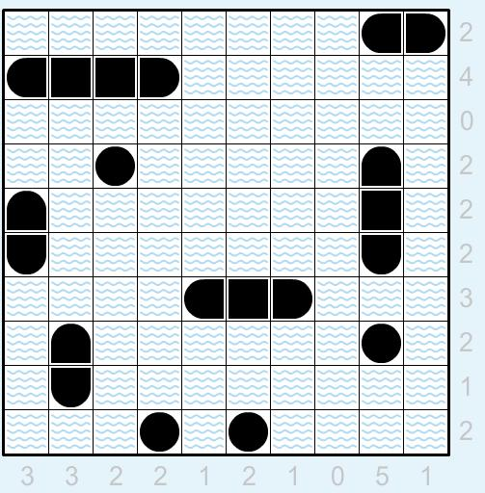
Python

Slide 4
Languages
Command Prompt (terminal)
HTML, CSS, JavaScript
PhP
Python
Graphic design
Others…?

Slide 5
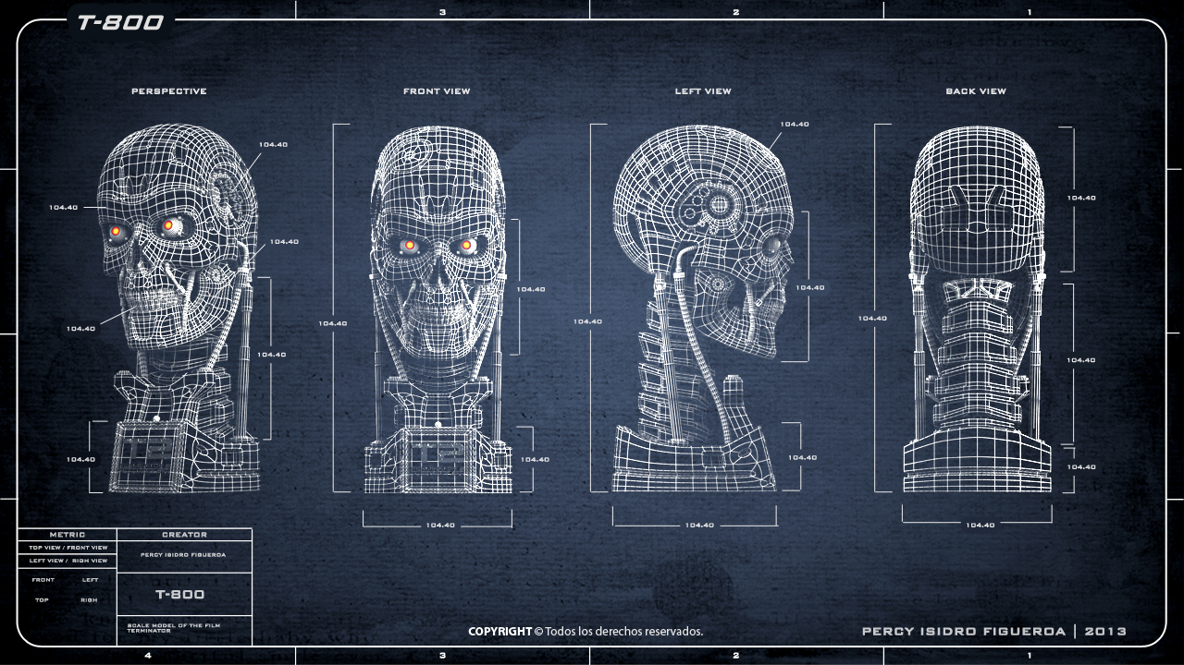
Building a Computer

Slide 6
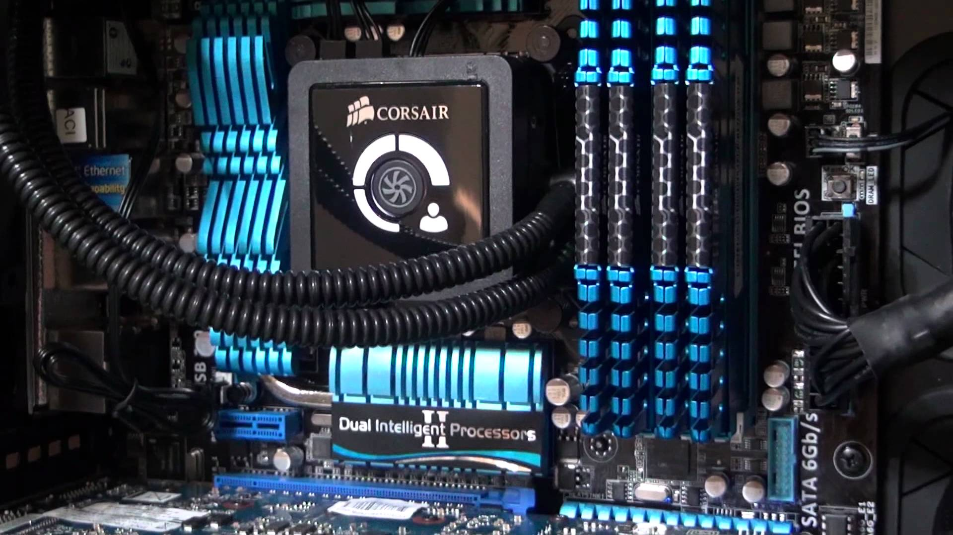
Building a Computer

Slide 7

Google Drive

Slide 8
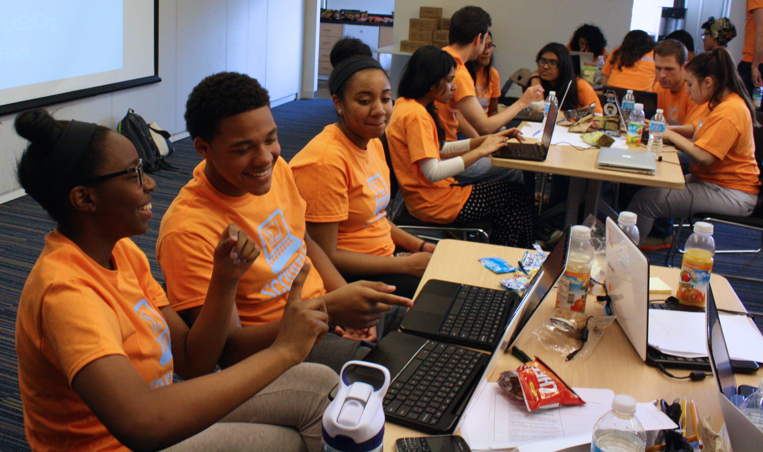
Hackathon

Slide 9
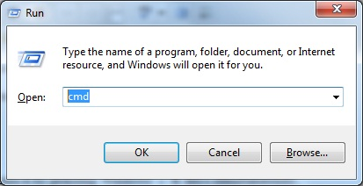
Run

Slide 10
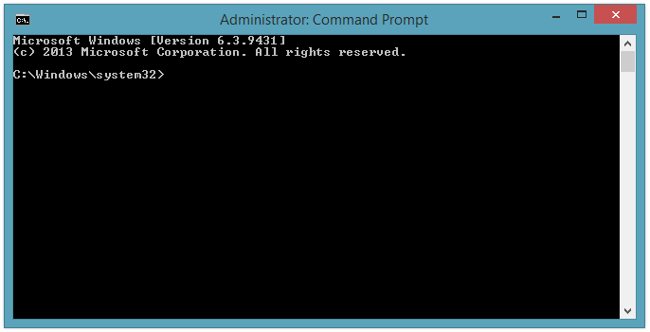
Command Prompt

